Slide 1
Shiraz University
«Image denoising Using Improved Wavelet Threshold Function and Median Filter»
Sadegh Jamishi
2021

Slide 2
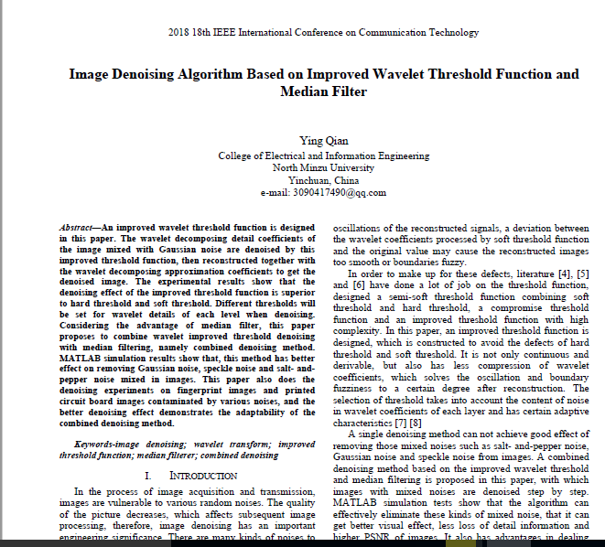
Article info

Slide 3

Introduction
Removing image noise is one of the most important and unavoidable operations in this field.
Many types of noise can infect the image, some of which are:
Retractable Gaussian noise
Salt and pepper noise: This noise, also known as impact noise, appears in completely black or white dots on the image.
Speckle noise: This noise is produced in a multiplicative way in the image and usually affects the ‘SAR’ images and ultrasound and tomography.
Poisson noise and ...
Existing noise may enter the image individually or in combination with several noises. Leza is an acceptable algorithm that can reduce all of this noise to a desirable level while keeping the image close to the original image.

Slide 4
Summary of existing noise cancellation methods
Denoising
Transforms
Noise and image specifications in the conversion space are different
Non data adaptive
ICA
PCA
Classic
Operate on the basis of the correlation between the pixels of the original image
Spatial Filtering
Modification methods
Total variation regularization
Non-local regularization
Sparse representation
Linear
Non Linear
data adaptive
spatial frequency domain
wavelet domain
Average filter
Wiener filter
Mediain Filter
Weighted Median

Slide 5
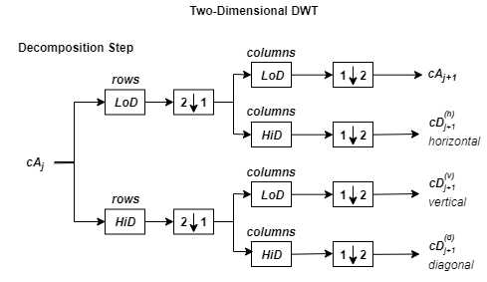
Wavelet transform
Simultaneous analysis of time and frequency (for images, location and frequency).
Analyzing images at different resolutions and frequency bands simultaneously and examine the horizontal, vertical and diagonal details of the images separately.
The following figure shows the general diagram of how to apply wavelet to image and the idea of multi-resolution image analysis. After extracting the image details, the noise in the image details can be removed by operation.

Slide 6
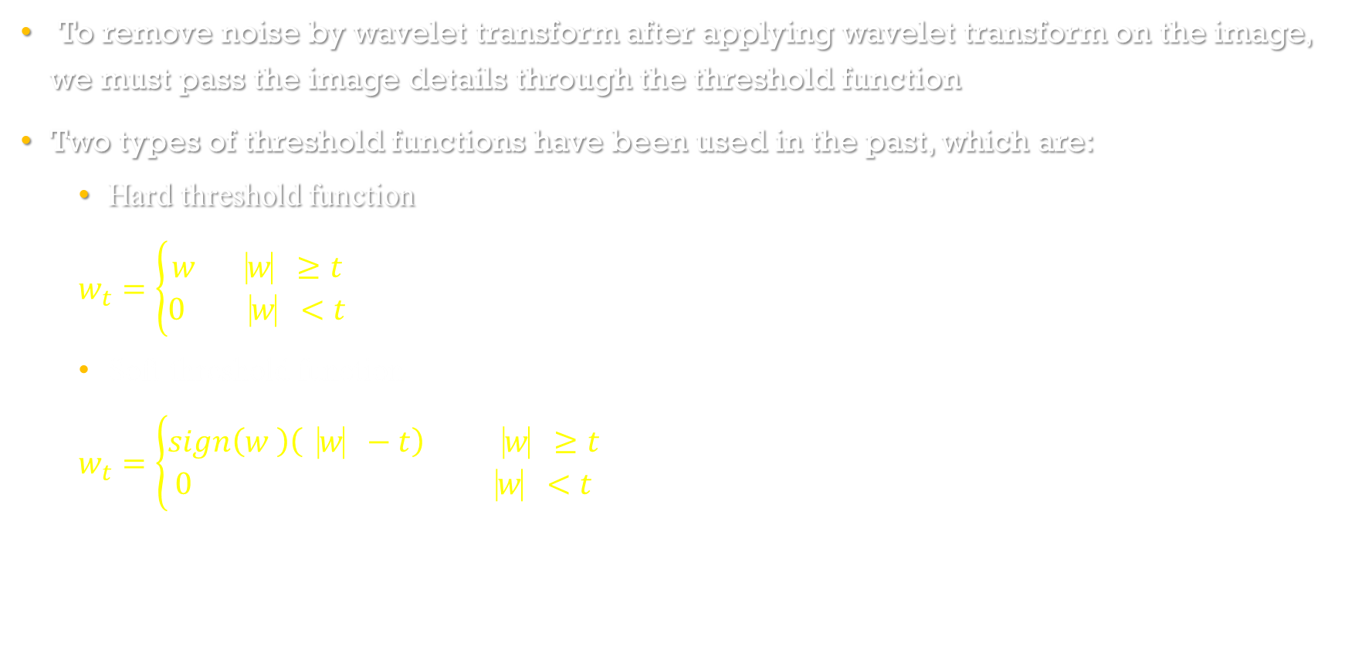
Wavelet transform and Noise Elimination (Wavelet Threshold Functions)
To remove noise by wavelet transform after applying wavelet transform on the image, we must pass the image details through the threshold function
Two types of threshold functions have been used in the past, which are:
Hard threshold function
$$w_{t}=\left\{\begin{aligned}w ⎹w⎸≥t \\ 0 ⎹w⎸<t\end{aligned}\right.$$
Soft threshold function
$$w_{t}=\left\{\begin{aligned}sign\left(w \right)\left(⎹w⎸−t\right) ⎹w⎸≥t \\ 0 ⎹w⎸<t\end{aligned}\right.$$

Slide 7
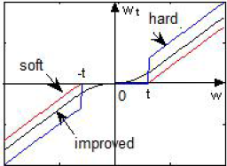

Wavelet transform and noise cancellation. Continued (improved threshold function)
defining the new improved threshold function with the aim of minimizing distortion and loss of image information as follows:
$w_{t}=\left\{\begin{aligned}\left[sign\left(w\right)\right].\left[\left|w\right|−\left(1−p\right)t\right] |w|≥t \\ p.\frac{{\left|w\right|}^{2}}{t} |w|<t\end{aligned}\right.$
p is a constant between zero and one that is chosen experimentally
We define the threshold as $t=\frac{σ\sqrt{2\ln\left(m×n\right)}}{2d−1}$ where d is the decomposition scale.
$σ, t$he standard deviation of the noise is calculated by the median estimator as median(|w|)/0.6745

Slide 8
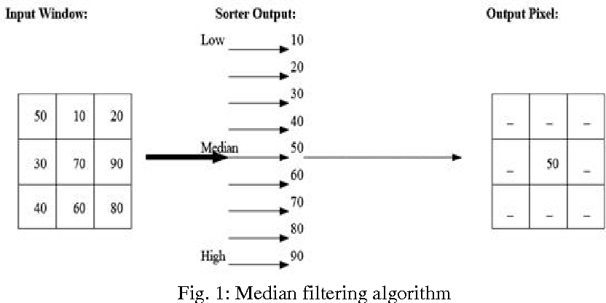
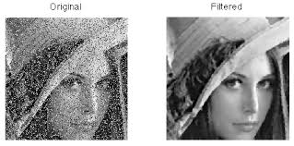
MEDIAN FILTER
The middle filter is one of the non-linear filters that works well in removing image noise, especially salt and pepper noise.
For each pixel of the image, we consider a window (for example, 3 * 3) around it and arrange the values of the window pixels, then we consider the middle value as the output in the desired pixel. Because the salt and pepper noise has only 0,1 values, the middle value of the window, which is not necessarily zero-one noise, replaces the noise and the noise is reduced.

Slide 9
Noise cancellation algorithm
First, we take a two-layer wavelet transform from the noise image and apply the improved threshold function to the image detail coefficients in each layer.
Then we reconstruct the image with the new wavelet coefficients obtained
Finally, apply the middle filter twice on the reconstructed image
Noisy Image
Two-layer wavelet transform and apply improved threshold function
Image reconstruction of wavelet coefficients
Applying the Median filter twice
Output Image

Slide 10
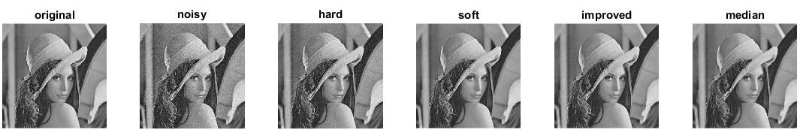


Simulation Results for Gaussian Noise (Part 1)
My results Article’s result
PSNR (dB) | Image
 | $x(n)$ | $$x_{h}(n)$$ | $$x_{s}(n)$$ | $$x_{i}\left(n\right)$$ | $$x_{m}(n)$$
PSNR 1 | 28.22 | 30.32 | 33.28 | 33.50 | 32.17
PSNR 2 | 23.1694 | 29.504 | 30.25 | 30.33 | 29.98
PSNR (dB) | Image
 | $x(n)$ | $$x_{h}(n)$$ | $$x_{s}(n)$$ | $$x_{i}\left(n\right)$$ | $$x_{m}(n)$$
PSNR 1 | 28.1401 | 31.0948 | 32.3809 | 34.3860 | 31.4948
PSNR 2 | 23.1312 | 27.1249 | 30.4492 | 32.5813 | 28.7860

Slide 11






Simulation results for hybrid noise
Article Results My Results
(1)
(2)
(3)
PSNR (dB) | Image
 | $$x_{1}(n)$$ | $$x_{1i}(n)$$ | $$x_{1m}(n)$$
PSNR 1 | 23.63 | 32.93 | 30.56
PSNR 2 | 19.97 | 30.44 | 28.18
PSNR (dB) | Image
 | $$x_{1}(n)$$ | $$x_{1i}(n)$$ | $$x_{1m}(n)$$
PSNR 1 | 23.68 | 30.53 | 29.12
PSNR 2 | 20.08 | 29.19 | 28.05
PSNR (dB) | Image
 | $$x_{2}(n)$$ | $$x_{2i}(n)$$ | $$x_{2m}(n)$$
PSNR 1 | 23.73 | 31.01 | 28.65
PSNR 2 | 20.20 | 29.28 | 26.61
PSNR (dB) | Image
 | $$x_{2}(n)$$ | $$x_{2i}(n)$$ | $$x_{2m}(n)$$
PSNR 1 | 23.44 | 30.70 | 30.15
PSNR 2 | 20.19 | 29.09 | 27.97
PSNR (dB) | Image
 | $$x_{3}(n)$$ | $$x_{3i}(n)$$ | $$x_{3m}(n)$$
PSNR 1 | 21.63 | 30.69 | 28.35
PSNR 2 | 17.68 | 27.75 | 24.97
PSNR (dB) | Image
 | $$x_{3}(n)$$ | $$x_{3i}(n)$$ | $$x_{3m}(n)$$
PSNR 1 | 21.68 | 30.25 | 29.20
PSNR 2 | 17.52 | 28.45 | 26.14

Slide 12
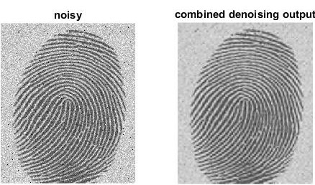
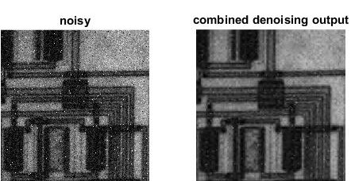
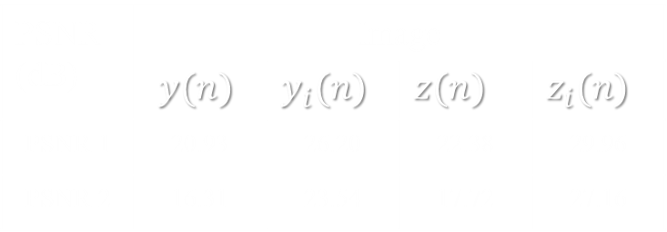

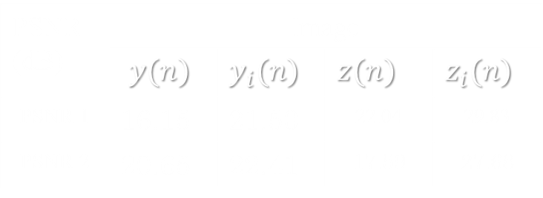
Simulation on applied images
$y \left(n\right)fingerprint noise image, z \left(n\right)circuit noise image and y_{i}\left(n\right)and z_{i}\left(n\right)are the output of the combined noise removal method.$
Article results compare with mine
PSNR (dB) | Image
 | $y(n)$ | $y_{i}(n)$ | $z(n)$ | $z_{i}(n)$
PSNR 1 | 20.93 | 26.20 | 22.38 | 29.96
PSNR 2 | 16.31 | 23.54 | 17.72 | 27.16
PSNR (dB) | Image
 | $y(n)$ | $y_{i}(n)$ | $z(n)$ | $z_{i}(n)$
PSNR 1 | 16.15 | 21.50 | 22.04 | 29.83
PSNR 2 | 20.65 | 22.41 | 17.59 | 27.68

